Slide 1

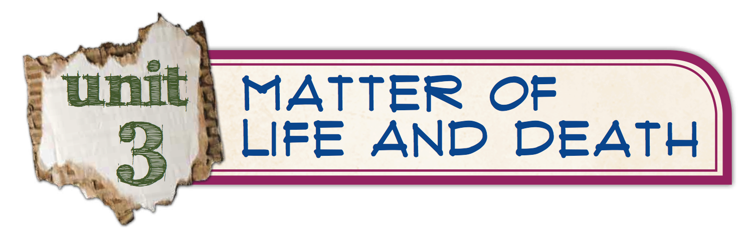
session 11
session 9: What does the Garden of Eden
have to do with us?
session 10: Bait and switch?
session 11: What is the true source
of the brokenness around us?

Slide 3
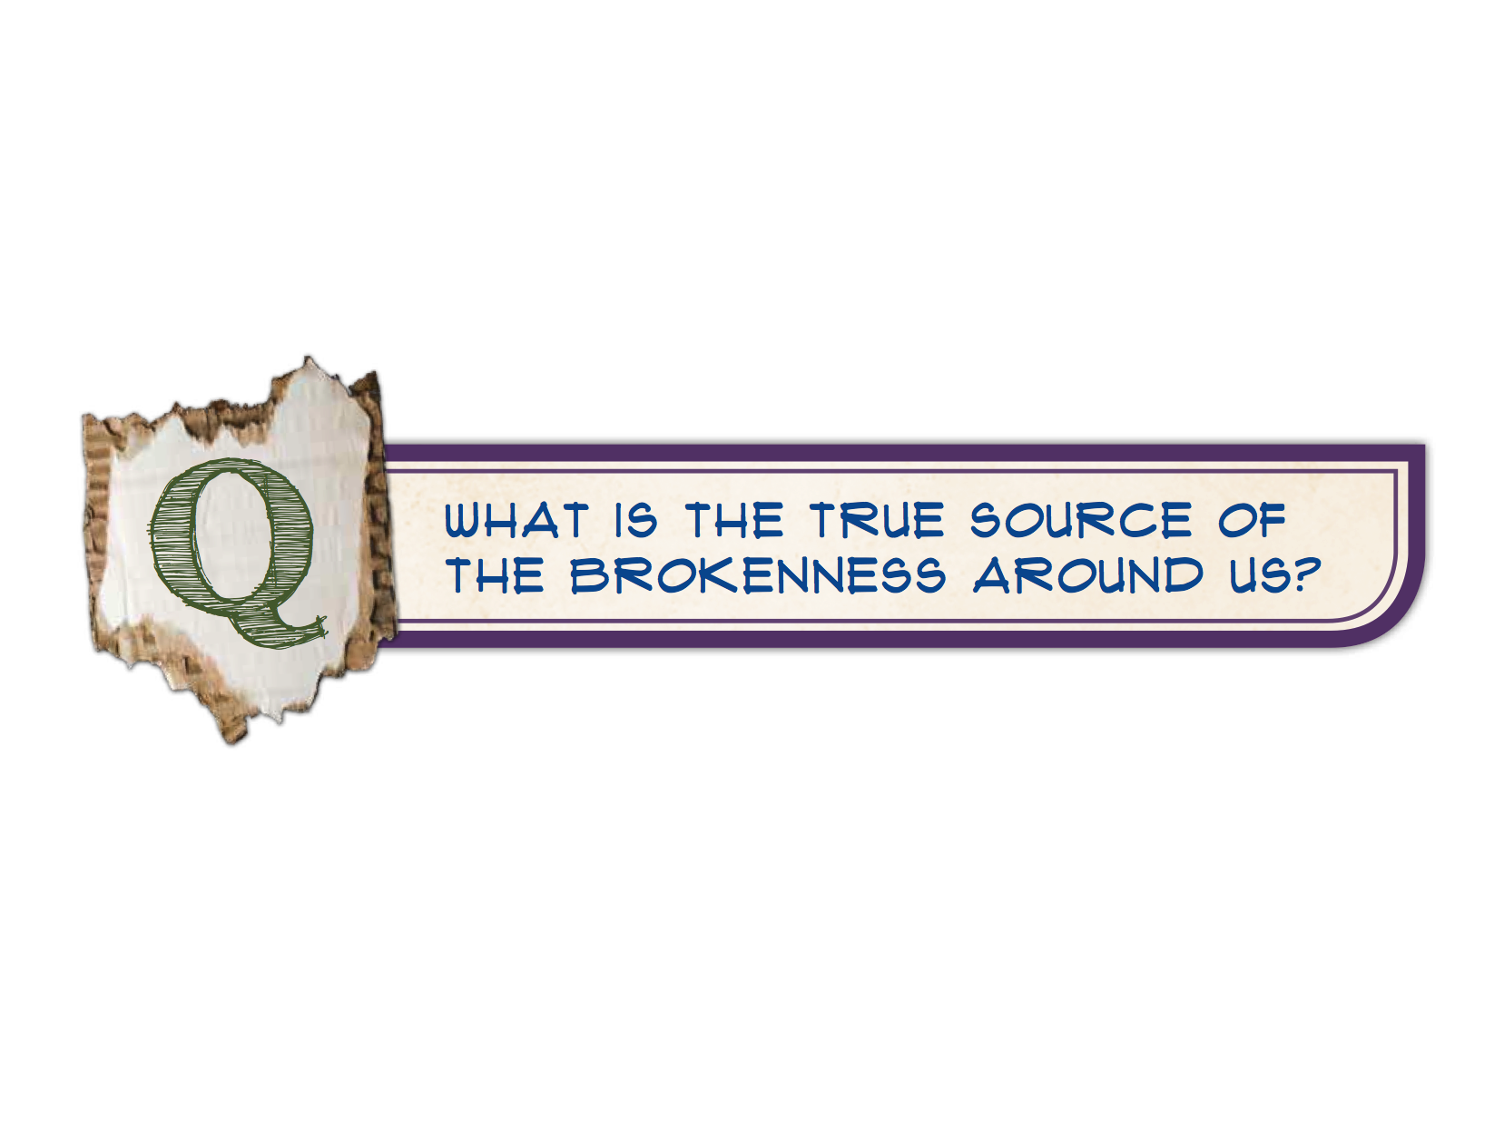
session 11

Slide 4
1. Why was Adam and Eve’s
choice so bad?
Genesis 3:1–19

Slide 5
2. How is death an alienation
from God, from one another,
and from creation?
Genesis 3:1–19

Slide 6
Genesis 1:28; 2:15–23
Genesis 2:20b–25
Genesis 1:28–30; 2:15, 19–20
Genesis 3:8–11
Genesis 3:7, 12, 16
Genesis 3:17–19

Slide 7

So, what is the true source of the brokenness around us?
The rebellion of Adam and Eve resulted in spiritual and physical death for everyone—
alienation from God,
from each other, and
from creation.

Slide 8
“Sin is inherently anti-God,
inherently pro-self.
Each time I sin I make a statement about myself and a statement about (and against) God.
Each time I sin, I declare my own independence,
my own desire to be rid of God;
I declare that I can do better than God,
that I can be a better god than God.”
—Tim Challies

Slide 9
So What?
Identity & Purpose
Copyright © 2013 Great Commission Publications.
All rights reserved.
Scripture quotations are from The ESV® Bible (The Holy Bible, English Standard Version®), copyright © 2001 by Crossway. Used by permission.
All rights reserved. ESV Text Edition: 2007
This publication contains copyrighted images from Thinkstock Corporation © 2013, and its licensors. Used under license. “How We Die” chart from New England Journal of Medicine, 2012, http://www.nejm.org/doi/full/10.1056/NEJMp1113569 via http://www.washingtonpost.com/blogs/ezra-klein/wp/2012/06/22/how-we-die-in-one-chart, accessed 2012. Quote: Tim Challies, http://www.challies.com/christian-living/when-i-am-god, accessed 2012.
Duplication of copyrighted material is not permitted.
Great Commission Publications
3640 Windsor Park Drive
Suwanee, GA 30024
800-695-3387
www.gcp.org
www.sowhatstudies.org

